Slide 1
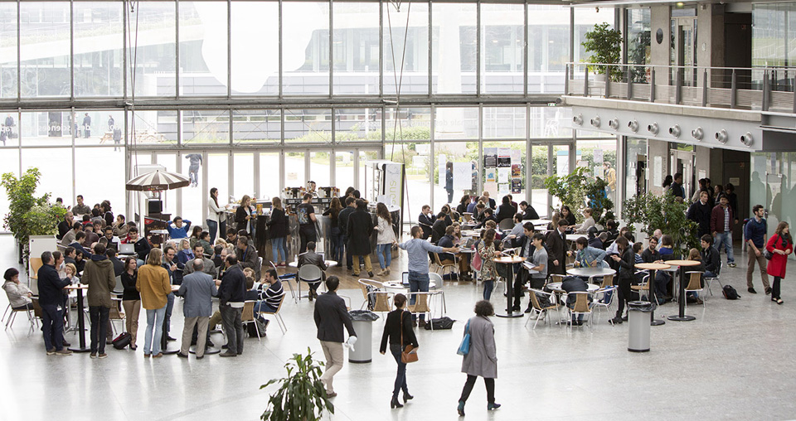
ÉCOLE DES PONTS PARISTECH
Building the worlds of tomorrow
July 2022

Slide 2
A world-class Higher Education and Research Institution
A public engineering school recognised for the excellence of its graduate studies
Founded in 1747
International outlook
A unique combination of fundamental and applied sciences, to transform business and society.
Flexible and interdisciplinary engineering curriculum
Leading to executive careers
Striving for the ecological and digital transition

Slide 3
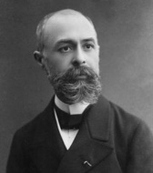
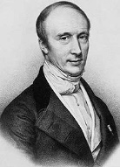
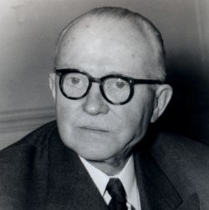
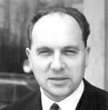

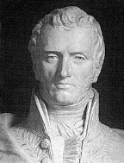
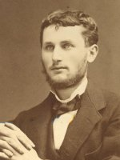
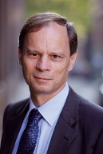
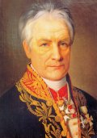
A long and prestigious history
The oldest School of engineering in Europe
1747: École nationale des ponts et chaussées founded by King Louis XV
1851: First research laboratory
1988: 1st Double Degree agreement with international universities
1997: Relocation in Marne-la-Vallée, Green City Campus
2021: Founding member of EELISA European University
Henri Becquerel 1852-1908 -Physicist- Nobel prize 1903 | Augustin Cauchy 1789-1857 -Mathematician- One of the founders of modern analysis | Eugène Freyssinet 1879-1962 -Engineer, entrepreneur- The father of prestressed concrete | Louis Ménard 1931-1978 -Engineer- Developer of the pressiometer
Claude-Louis-Marie-Henri Navier 1785-1836 -Engineer, scientist- Inventor of general theory of elasticity | Jean Résal 1854-1919 -Engineer- Builder of the pont Mirabeau and pont Alexandre III in Paris | Jean Tirole 1953-… -Economist- Nobel prize 2014 | Louis Joseph Vicat 1786-1861 -Engineer- Inventor of concrete

Slide 4

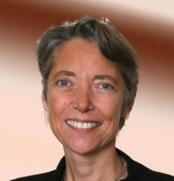

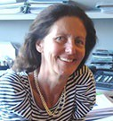
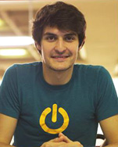
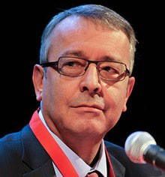
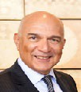
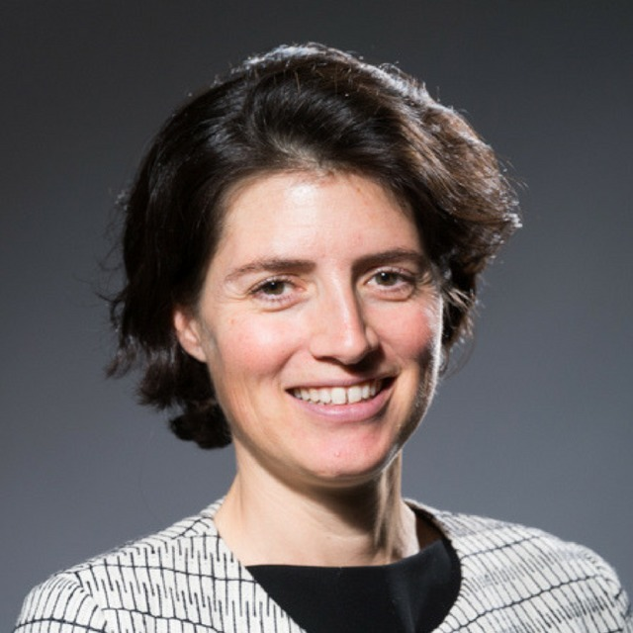
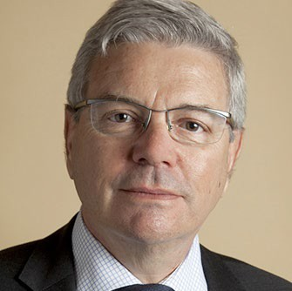
Alumni in industry and government
Benoit de Ruffray
Ponts 93
CEO Eiffage
Diane D’Arras Ponts 77
Directrice déléguée Eau
Europe, Présidente IWA
Elisabeth Borne
Ponts 86
Première Ministre
Thibault Duchemin
Ponts 2013
Founder AVA
François Bertière
Ponts 74
ex P-D.G. de Bouygues Immobilier
MostafaTerrab
Pont 79
CEO OCP Group
Antoine Frérot Ponts 82
P-D.G. Véolia Environnement
Christelle Heydemann
Ponts 97
CEO Orange

Slide 5
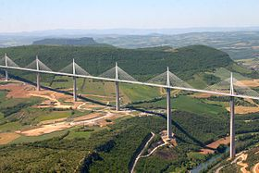
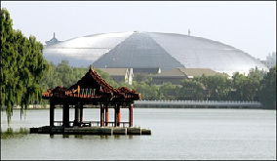
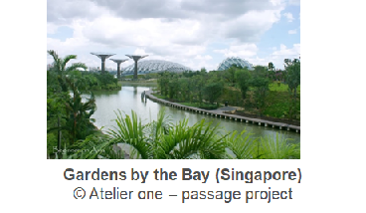
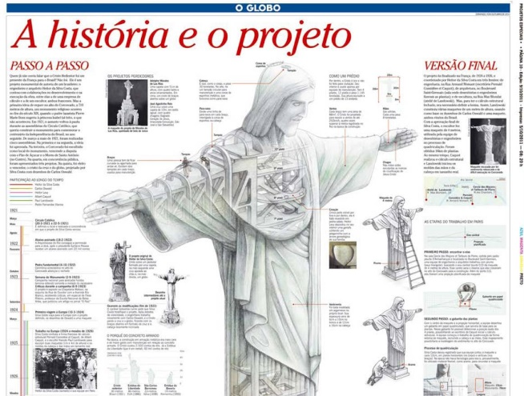
Remarkable works, designed by
Ecole des Ponts ParisTech Alumni
Viaduc Millau - Michel Virlogeux
Cristo Redentor
Albert Caquot

Slide 6





Rankings and certification
International QS Rankings 2023: + 71 spots in one year.
#174 worldwide
#180-190 Graduate Employability Ranking
#6 France
2022 THE (Times Higher Education) international ranking: +8 spots in one year.
#251-300 worldwide
#1 France < 5000 students
National Etudiant ranking 2022:
#4 France
Choose France certification
Highest level of certification of welcome procedures and programmes for international students
AFAQ ISO 9001 certification
Quality management

Slide 7
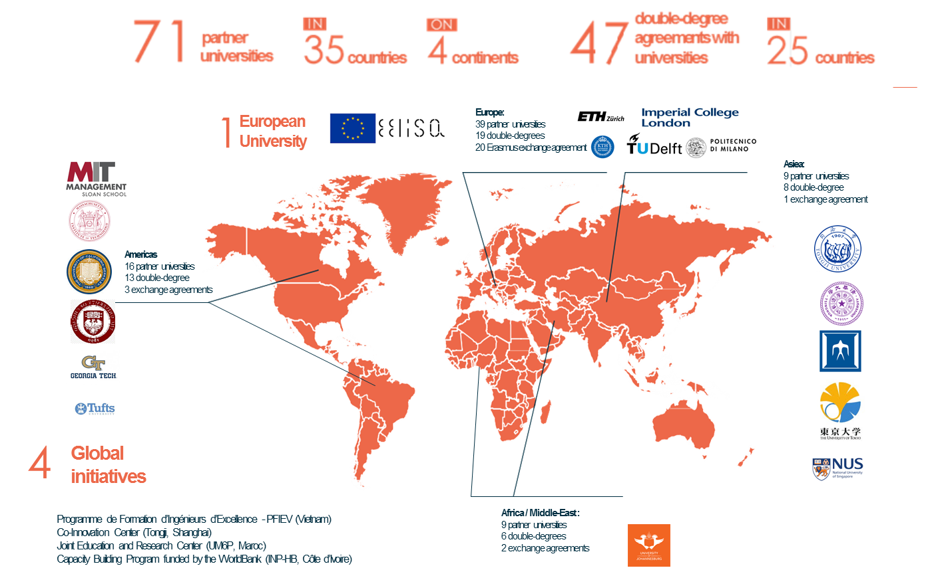




International partnerships

Slide 8





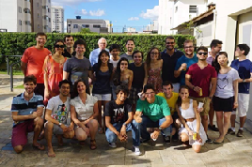
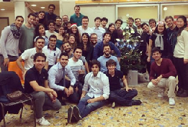
Ecole des Ponts ParisTech and Brazil
Academic partnerships, and Research cooperation
Long standing relations with top Universities
Brazilian students are #1 international students : 30 / year
Aproximadamente 250 antigos alunos residindo e trabalhando no Brasil
Encontro Ponts-Brasil - 2014
“Brasil na Ponts” - 2014/2015

Slide 9
Governance and funding
State-owned institution
Reports to the Ministry for the Ecological Transition
and to the Ministry of Higher Education, Research and Innovation
Governing bodies:
Board of Directors, 24 seats, 8 for industry representatives
Graduate School Council
Scientific Council
Funding:
Annual budget: 47 M€
50% by the Ministry for the Ecological Transition
50% by industry

Slide 10
Key facts and figures
Students :
870 students in the MSc in engineering / Diplôme d’ingénieur
130 in Master’s programmes
300 in Advanced Master’s programmes
500 PhD candidates and postdocs
200 in Business Administration programmes
i.e. a total of: 2 000 students, 33% female
45% international students, 45 nationalities
1 200 instructors (academics, researchers, business practitioners)
12 research laboratories
7 labs of excellence
450 permanent scientists
14 education and research chairs
1000 rank A publications, including 45% with a foreign partner

Slide 11

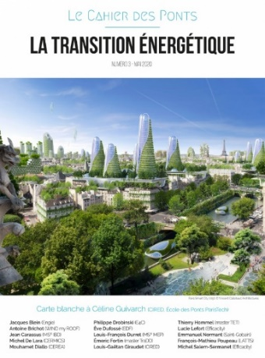
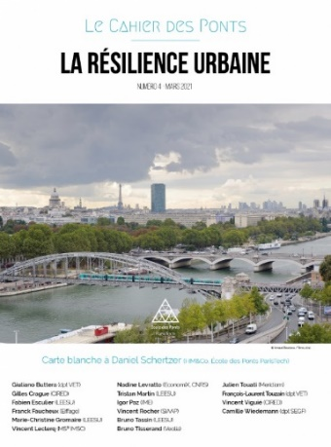
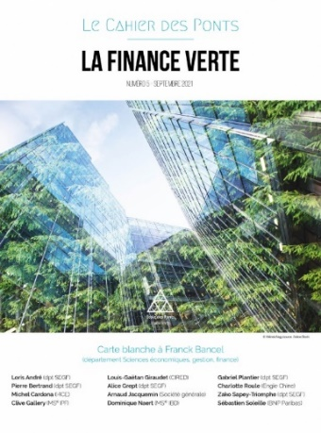
The school of the Ecological transition
    Governing Ministry’s name: from Sustainable Development (2007-2017) to Ecological Transition (2017 > )
    A history of combining engineering and social sciences for effective, relevant and appropriate technologies
    12 Research centers covering 11/17 Sustainable Development Goals (United Nations)
    One « European Research Institute » Energy for Climate
    Develop’Ponts : the student union committed to sustainable development, solidarity actions, inclusion for the society and the environment
    10 /14 industrial chairs, addressing the ecological transition: 3 in sustainable development, 2 in environment, 5 in sustainable transport and mobility

Slide 12
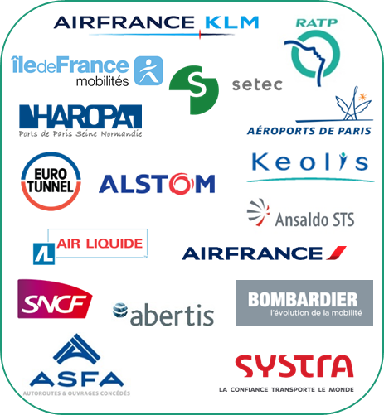











































Close links with industry
Energy
Industry
Transportation,
environment,
urban services
Consulting
Construction
Finance

Slide 13
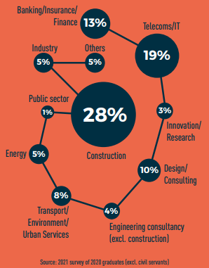
Careers and placement
85% of engineering students are hired before graduation

Slide 14




Academics: graduate programs
“Diplôme d’ingénieur
(MSc-Master of Science in Engineering)
0
MS- Advanced Masters
3
Master
5
PhD
Bachelor
National competitive exam
Master
8
PhD
8 years
Industry-oriented
Research-oriented

Slide 15
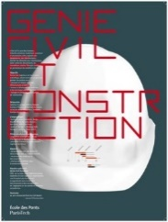





Academics: Departments of studies
Civil and Structural Engineering
Complex projects, site work organisation, innovation of new materials and construction technologies
City, Environment, Transportation
Planification of complex urban systems and operation of urban services (transportation, water,…)
Mechanical Engineering and Material Science:
Research and design of new products and materials in the fields of energy or transportation
Industrial Engineering:
Innovation and supply chain. Robotics.
Economics, Management, Finance:
Financial engineers( financial engineering, project finance, public/private partnerships) and economist engineers (urban, environment, transportation, construction and economic regulation)
Applied Mathematics and Computer Science:
Modelisation of complex systems ; analysis of financial, industrial or natural risks ; challenges within big data

Slide 16



International Master’s programmes
International masters
Masters in Transport and Sustainable Development (TRADD)
Master in Water, Soil and Waste Management and Treatment (GTESD)
Master Internacional en Empresa y Políticas Públicas (MIEPP) – institutional degree (Madrid)
MSc
Sustainable Impact Analysis (SIA)

Slide 17

Master’s programmes
Civil Engineering
Mechanics of Soils, Rocks, and Structures in their Environment (MSROE)
Materials Science and Engineering
Materials science for sustainable construction (SMCD)
Transportation, Mobility, Networks
Transportation, Mobility (TM)
Environmental, Energy, and Transportation Economics
Environmental Economics
Energy Economics
Forward Modelling
Quantitative Economics
Analysis and Political Economy (APE)
Public Policies and Development (PPD)
Applied Mathematics
Probabilities and random models (PMA)
Mathematics of finance and data (MFD)
Mathematics, Vision, Learning (MVA)
Modelling, Analysis, Simulation (MAS)
Operational Research (RO)
Energy option
Decommissioning and Waste Management (DWM)
Energy Transition and Territories (TET)
Mechanical Engineering
Multiscale Analysis for Materials and Structures (AMMS)
Durability of materials and structures (DMS)

Slide 18



Advanced Master’s programmes Executive Education
FULL-TIME
Planning and Urban Commissioning
Urban Engineering and Information Technology (Urban ICT)
European civil engineering
Engineering of Large Energy Structures
Public Policy for Sustainable Development
PART-TIME
Design by Data, Computational Design, Digital Manufacturing and Building Technologies
Sustainable Real Estate and Building, energy transitions and digital technology
BIM, Integrated Design and Life Cycles of Buildings and Infrastructures
Smart Cities Engineering and Management
Decision Support and Geolocated Information Systems
Rail and urban transit systems
Smart Mobility - Digital transformation of mobility systems
Supply Chain Design & Management
Infrastructure Project Finance
Advanced Public Action Morocco
Management of Energy Projects

Slide 19
PhD Programmes
City, Transportation, and Territories
Sciences, Engineering, and Environment
Mathematics and ICT
Organizations, Markets, Institutions
Agriculture, Food, Biology, Environment and Health
Social Science
Environmental Sciences
Astronomy and Astrophysics
Mechanical, Energy, Materials Sciences and Geosciences
Economics
English-speaking environment
Choose PhD@Ecole des Ponts ParisTech for:
International perspective
Close links with industry
Impact on public policies and sustainable development

Slide 20




Business Administration programmes
Executive DBA (Paris – New York)
LEADTECH Global Executive MBA (Paris – Barcelona – Singapore – Silicon Valley)
Global Executive MBA (Casablanca)
Executive Certificates (Africa)
Executive MBA in aviation management with Tsinghua University (Beijing)
DBA –Intelligent Manufacturing Management- (Shanghai)
Certificate in Innovation and Technology Management (Paris)

Slide 21



Non-Degree English-taught Programmes
Level | Topic | Academic program | Specifics
Bachelor-senior students | Applied Mathematics | Mathematical tools for engineer Analysis and scientific computing Optimization Probability Introduction to programming Statistical physics Operational research and optimization Statistics & data analytics Language (French) Sport Project within lab | Bespoke academic supervision and small class teaching Full Ecole des Ponts ParisTech student and research experience
Graduate students | Green Finance | Physics of climate change Energy economics ESG analysis Green financing Conferences Credit Risk Management of Climate Risks Project Finance Life Cycle Analysis Capstone Projects | Extension to 1 semester of research at CIRED laboratory

Slide 22


An entrepreneurial ecosystem for students
    Entrepreneurship courses
    2 incubators (Descartes, Station F), 1 accelerator
    Annual Hackathon: « One night to launch a startup »
    Access to research equipment and mentorship
    Special awards, and seed-funds from Fondation des Ponts

Slide 23

Research for the ecological and digital transition
      A challenge-based approach to address 4 socio-economic issues of sustainable development
Industry of the future
City and mobility systems
Economy, practices and society
Management of risks, resources and milieus

Slide 24
Research for the ecological and digital transition
Ecomaterials
Digital Manufacturing
Innovative Structures
Geomechanics
Sustainable mobility
Territorial dynamics
NAVIER
LVMT
Modelisation of uncertainty
Digital simulation
Systems optimisation
Urban waters
Alternative resources
CERMICS
LEESU
Data processing
3D vision
Big data
CEREA
Atmospheric environment
Air quality
Renewable energy
LIGM
Cities of the future
Infrastructures
Practices
LATTS
HM&Co
Hydro-meteorological risks
Resilient cities
Public policies
Environmental economy
Markets and governance
PjSE
LMD
Physics of atmosphere
Climate
CIRED
LHSV
Sustainable development
Climate change
Renewable energy
Natural risks

Slide 25


Research for the ecological and digital transition
Predictive Maintenance
Industry 4.0: how to use data to enhance competitiveness

Slide 26




Research for the ecological and digital transition
Renewable Energy
Onshore and offshore marine energy
Wind farms and solar
Smart grids

Slide 27


Research for the ecological and digital transition
Resilient Cities: mobility, water, air.
Smart & Sustainable Mobility
Extreme rains
Air Quality

Slide 28
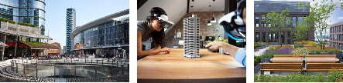



Research for the ecological and digital transition
Sustainable buildings and infrastructures
Ecodesign of buildings and infrastructures
Materials Science for Sustainable Construction
Green roof performance

Slide 29
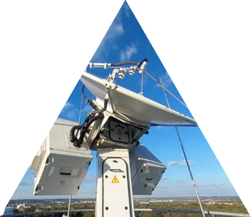
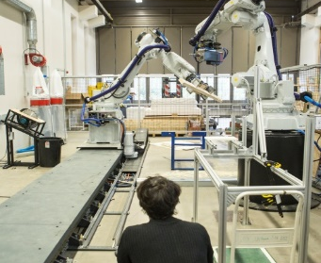
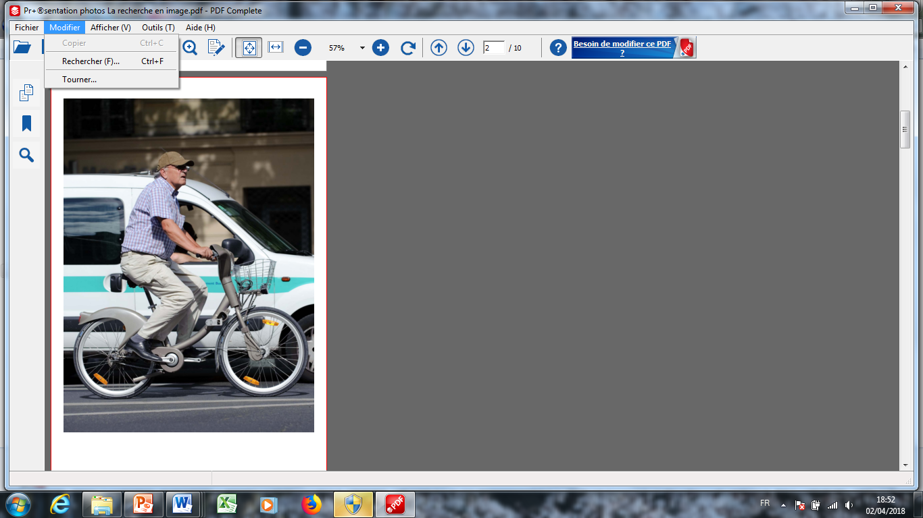
The Co-Innovation Lab
Collaborative platforms improving transfer to industry
Fresnel : multi-scale observation and modelling platform for resilient cities
X-band dual polarisation weather radar, lidars, disdrometer…
Build’In : building systems and artificial intelligence, materials and structures optimisation, industrial processes
Robotic hall, large-scale additive manufacturing unit, concrete and composite materials modelling …
Mµ : urban mobility modelling, new behaviors, infrastructures and urban planning, impact of public policies
Softwares, traffic simulators…
Notes:
...

Slide 30
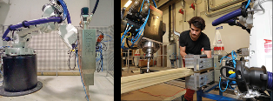
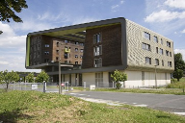
Maker space | d.school
Makerspace
3D Printing,
Laser cut
4 poles (ceramic, wood, steel, water, electronics)
d.School Paris
Design Thinking as an approach to innovation and its management
56 PARTNERS
CORPORATE
74 PROJECTS
PROFESSIONAL
100
ALUMNI EXPERTS
- innovate – collaborate – share -

Slide 31
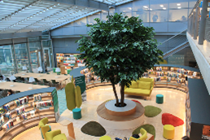
Library, Heritage and Publishing.
La Source, Learning Center
250 seats
200 000 documents
Open 71 hours/week
Scientific information
services for researchers
25 000 scientific publications
HAL ENPC Open Science Plan (65% publications in open access)
Archives
Exceptional heritage
Ancient manuscripts and maps since the 18th century.
Presse des Ponts
220 books and scientific and technical software applications primarily in the fields of civil and structural engineering, and spatial planning

Slide 32



  Campus Cité Descartes
  Greater Paris green cluster
Housing (on campus or in Paris center)
Sport facilities
Vibrant campus life
15 student societies
20’ from Paris center (direct urban train)
International students welcome desk with « Feel Français »

Slide 33


Alumni endowment and support
22 000 alumni worldwide, holding leadership positions in 100 countries
14 international groups
Bespoke mentoring for international students over their stay in France
Support for careers and internships
Special scholarships program for international students
Corporate Scholarship (Meridiam)
Excellence awards
A powerful network of donors

Slide 34

« Diplôme d’ingénieur » (MSc in engineering)_International students
Bachelor cycle
At home institution
Master cycle
At Ecole des Ponts ParisTech
> Choice of a Department of studies
Civil and structural engineering
City, environment, transportation
Mechanical engineering and materials science
Industrial engineering
Economics, Management, Finance
Applied mathematics and computer science
Industrial internship
3 months or 1 year
France or abroad
Final Project / Master thesis
For at least 4 months, students apply the skills acquired in their programme to a scientific or technical problem, in a company or research laboratory.
Human-sized classes
30% international
25 nationalities
7 Semesters |  | Master courses | Master courses | Internship | Master courses | Final project / Master thesis | Semester 10
> Home university in Brazil |  | > Ecole des Ponts ParisTech |  | FR, BR or WW |  | > FR / BR or WW | > Home university in Brazil

Slide 35
Double-degree curriculum for Brazilian students
Double Degree
Professionnal course
Semester 10
Semester 9
Semester 8
Semester 7
Semester 6
Semester 5
Semester 4
Semester 3
Semester 2
Semester 1
ENPC S6 – PFE
ENPC S5
Internship 3 > 12m
ENPC S4
ENPC S3
ENPC S2
ENPC S1
Semester 4
Semester 3
Semester 2
Semester 1
Specialization
Fundametal course
Preparatory class
Fundamental course

Slide 36
Application process
Double-degree and non-degree student exchange
  European Autumn session
Phase | Nomination by EP-USP | Application online | Remote Interview | ENPC Admission Jury | Deadline for sending certificates | Beginning of the academic year
Deadline | Early September | September 30th | Mid-October | Mid- November | Early June | Last week of August
Criteria | GPA Ranking by class Professional project Letters of recommendation | https://crm.enpc.fr/community/enpc/custom_forms/184 | 30mn Motivations | Academic excellence Clarity of the project Recommendation letters Interview Maximum 6 students Maximum 4/departement | A2 in French (B1 for VET Urban planning track) TOEIC 785 | Assessment of language level, and upgrading courses in mechanics (in September)
  Application process
  European Spring session : for non degree exchange students only (2 semesters of coursework)
Phase | Nomination by EP-USP | Application online | Remote Interview | ENPC Admission Jury | Beginning of the academic year
Deadline | Mid March | March 31st | Mid-April | Early May | Last week of August
Criteria | GPA Ranking by class Statement of purpose Letters of recommendation | https://crm.enpc.fr/community/enpc/custom_forms/184 | 30mn Motivations | Academic excellence Clarity of the project Recommendation letters Interview Maximum 3 students | Assessment of language level,

Slide 37
Organization of courses in Departments of Studies
Civil and
Structural
Engineering
City,
Environment,
Transportation
Industrial
Engineering
Mechanical Eng.
& Material
Sciences
Applied Maths
& Computer
Science
Economics,
Management,
Finance
Y3 - Semester 2 : End-of-study project (17 weeks minimum)
S2
3 tracks for Y3 :
- Civil Engineer
- Researcher Engineer: Master (M2) : AMMS, MSROE or SMCD ⁽¹⁾
3 tracks covering Y2 & Y3 :
Urban planning : economics, legal, territorial analysis &, environmental aspects of urban development operations
Transportation :
traffic engineering,
3 tracks for Y3 :
Data science for industry
Innovation & design
Master (M2) :
Operational research
or Energy transition at
Local Scale
or Transport and
Sustainable
Developpement
2 tracks for Y3 :
Classic
Classic + Master (M2) :
SMCD ⁽¹⁾
or AMMS ⁽¹⁾.
or Durability of
materials & structures
or Energy :
Decommissioning and
Waste Management
4 tracks covering Y2 & Y3
- Probability & Finance
=> Y3 : at school or Master Maths for Finance & Data or Master Probability & Random Models
- Optimization
Y3 : at school or Master Operational Research
3 tracks for Y3 :
Sustainable and Green Finance
Economics (at Paris School of Economics)
Infrastructure Project finance
Year 3
M 2
Level
S1
Internship between Y2 & Y3 - 2 options : 12 weeks minimum or 43 weeks minimum
Courses focusing on :
Mechanics and dynamics applied to soils, fluids & structures
Thermics
Structural design
Drawing
Modelling
Transportation (Continued):
territorial analysis,
transport economics
- Environment :
Hydrology, water
treatment, air
pollution, energy
Sem 1 : Supply chain, operational research, modelling, project , …
Sem 2 : 2 tracks
- Engineering of design
and innovation
- Eng. of operations and
optimization
2 tracks differing by the nature of pedagogy :
Design of industrial systems : project oriented, robotics and prototyping
Modelling : emphasis on solving equations
- Vision & learning
=> Y3 : at school or Master Maths, Vision, Learning
- Modelling
=> Y3 : at school or Master Modelling, Analysis, Simulation
2 tracks for Y2 :
Economics : urban economics, sustainable dvt, transportation eco. & dvt eco. …
Finance: corporate, project and sustainable finance
Year 2
(S1&S2)
M 1
Level
AMMS : Multiscale Approaches for Materials and Structures; MSROE : Mechanics of Soils, Rocks and Structures in their Environment;
SMCD : Materials Science for Sustainable Construction
Detailed curriculum and pre-requisites: https://ecoledesponts.fr/en/academic-departments

Slide 38
Civil and structural engineering
Year 2 (M1)
https://ecoledesponts.fr/en/civil-and-structural-engineering
You must validate at least 48,5 ects in scientific courses
to validate your Year 2 (M1)

Slide 39
Civil and structural engineering
Year 3 (M2)
https://ecoledesponts.fr/en/civil-and-structural-engineering

Slide 40
Civil and structural engineering : Prerequisites
  •Solid mechanics
  •Scientific analysis and calculation
Kinematics and dynamics of non-deformable solids
Geometric Transformation: Eulerian and Lagrangian Descriptions
Internal stresses for 3D continuous medium: Cauchy stress tensor, Green-Lagrange strain tensor, linearization
Thermodynamic approach to linear thermoelastic behavior, three-dimensional linear thermo elasticity problems
Flat deformations
Theorem of kinetic energy
The Theorems of Minimum Potential Energy and Complementary Energy
Principle of the finite element method in linear elasticity
Linear elasticity finite element method
Concepts of Limit Analysis and the Study of Linear Elastic Curvilinear Media
Fundamental numerical methods for the engineer: finite differences for time integration of evolutionary equations, finite elements for solving variational problems.
Linear algebra, matrix calculus, tensor calculus.
Laplace transform, Fourier transform.
Partial differential equations and finite elements
  •Probabilities
Fundamental notions (probability space, random variable, law, expectation ...)
Usual laws with real and integer values.
Concepts of convergence
Strong Law of Large Numbers
Central Limit Theorem
Main algorithms for simulating random variables
Monte-Carlo method
  •Fluid mechanics
Eulerian Kinematics
Euler's equations
Navier-Stokes equations
Reynolds Number Irrotational plane flows of perfect incompressible fluid
Actual and complex potential
Conformal transformations
Transformation and Zhukovsky profiles
https://ecoledesponts.fr/en/civil-and-structural-engineering

Slide 41
Your budget
Tuition and fees
Tuition: 64800€/year. Waived
Fees (CMCI): 1000€/year
Monthly Cost of living in Paris: ~850€
Housing (including APL)
- Residence Meunier: 400€ or
- Maison des Mines et des Ponts: 250€
- Less Gvt Housing allowance : 150/200 €
Transport (Greater Paris): 40€
Food: 300€
Entertainment: 200€
Incidentals: 100€
Scholarships
Eiffel: 1180€/month
Fondation des Ponts: 650€/month over 15 months
Corporate scholarships (Meridiam)

Slide 42
Contacts :
Marie-Christine BERT :
Director of International Relations and Corporate Partnerships
marie-christine.bert@enpc.fr
Emmanuel SIMANTOV :
Head of international mobility
emmanuel.simantov@enpc.fr
Useful links :
School website : https://www.ecoledesponts.fr/en
Course catalogue : http://gede.enpc.fr/
Student union (in French) : https://bde.enpc.org/

Slide 43
ÉCOLE DES PONTS PARISTECH
Building the worlds of tomorrow
www.enpc.fr/en

