Slide 1


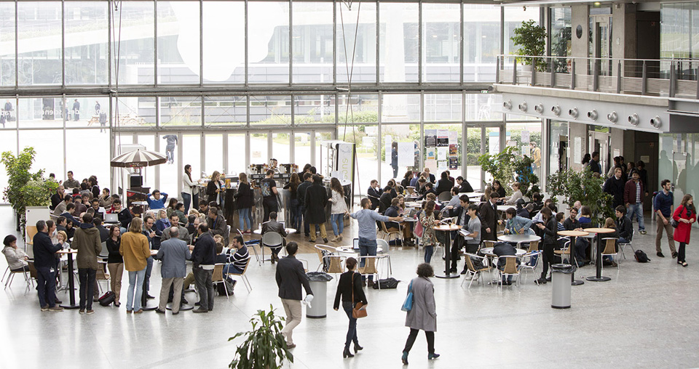
ÉCOLE NATIONALE DES PONTS ET CHAUSSÉES (ENPC)
The graduate school for the Ecological Transition

Slide 2
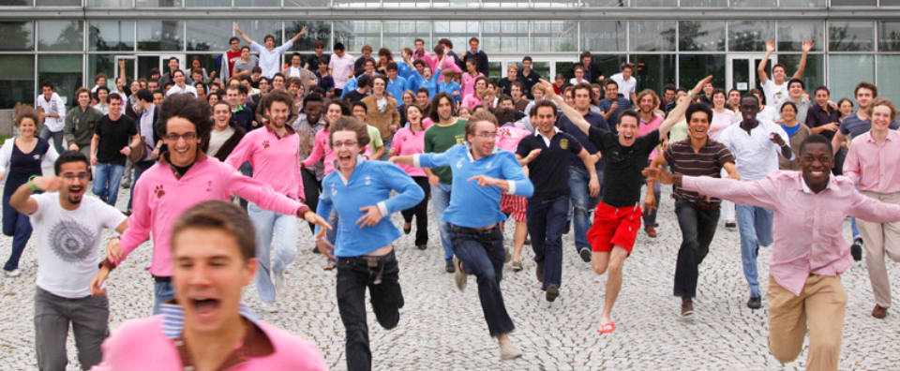
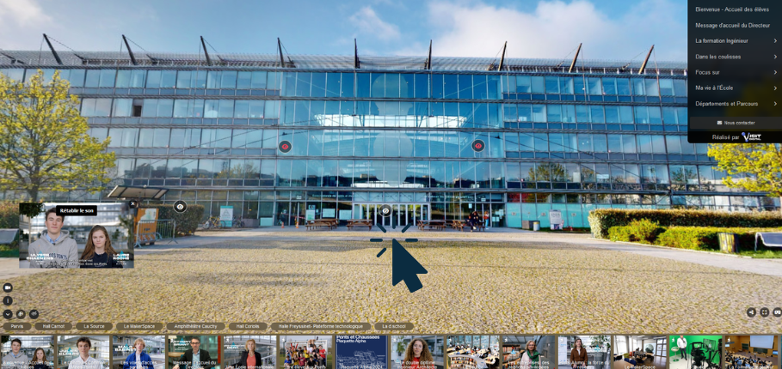



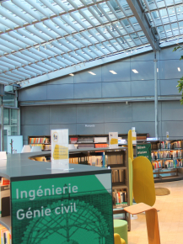



ENPC in a nutshell
1747
Established
EDUCATION PROGRAMS
Civil and Structural Engineering
City, Environment, Transportation
Industrial Engineering
RESEARCH EXCELLENCE
Economics, Management, Finance
Economics & social sciences
Mechanical Engineering and Materials Science
Environmental sciences and engineering
Applied Mathematics and Computer Science
Mechanics and physics of materials and structures
Mathematics and computer science
GLOBAL REACH
14 Industrial research chairs
+70 International agreements
40% international students
+20,000 alumni worldwide
1500 STUDENTS
85% master level
15% PhD level
31% of women

Slide 3
A few words about
Ecole nationale des ponts et chaussées

Slide 4
What is Ecole nationale des ponts et chaussées ?
A School with a long and prestigious history
  Creation by 1747 by King Louis XV
  Nobel prizes and renowned scientists
A unique combination of fundamental and applied sciences to transform business and society :
  Flexible and interdisciplinary engineering curriculum
  leading to top level positions in governments or companies
A world-class Higher Education and Research Institution
  Top 200 worldwide (QS) or top 500 (THE) in 2024
  Top 20 worldwide in 2024 for HEI < 5 000 students (THE)
  Top 11 in France en 2023 (L’Etudiant)
A public engineering school dedicated to the ecological transition :
  Reporting Ministry : Ministry for the Ecological Transition
  And the Ministry for Higher Education, Research and Innovation.
A School with an international outlook
A school with close links with industries

Slide 5
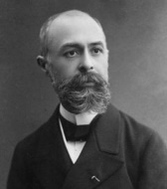
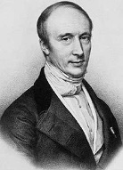
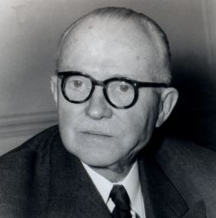
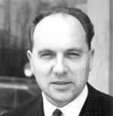

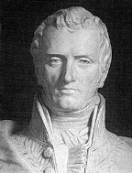
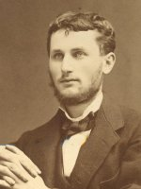
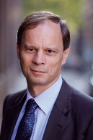
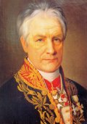
A long and prestigious history
Among the oldest schools of engineering in Europe
1747: École nationale des ponts et chaussées (ENPC) founded by King Louis XV
1851: First research laboratory
1988: 1st Double Degree agreement with international universities
1997: Relocation in Marne-la-Vallée, Green City Campus
2021: Founding member of EELISA European University
2024: Integration to Institute Polytechnique of Paris
Henri Becquerel 1852-1908 -Physicist- Nobel prize 1903 | Augustin Cauchy 1789-1857 -Mathematician- One of the founders of modern analysis | Eugène Freyssinet 1879-1962 -Engineer, entrepreneur- The father of prestressed concrete | Louis Ménard 1931-1978 -Engineer- Developer of the pressiometer
Claude-Louis-Marie-Henri Navier 1785-1836 -Engineer, scientist- Inventor of general theory of elasticity | Jean Résal 1854-1919 -Engineer- Builder of the pont Mirabeau and pont Alexandre III in Paris | Jean Tirole 1953-… -Economist- Nobel prize 2014 | Louis Joseph Vicat 1786-1861 -Engineer- Inventor of concrete

Slide 6
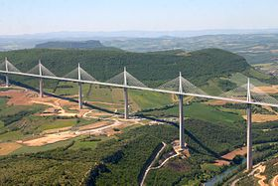
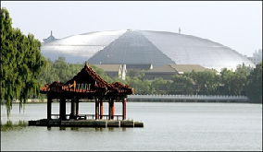
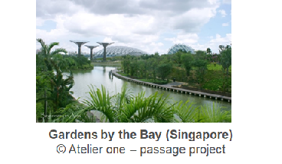
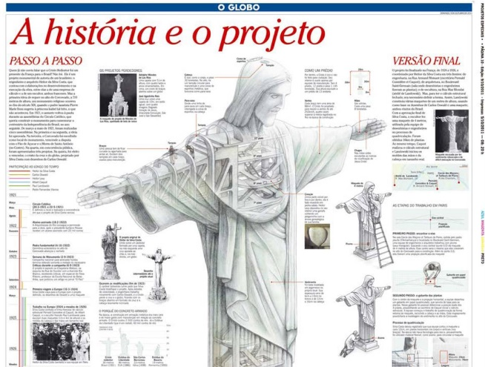
A long-term relationship between
ENCP & China
Remarkable works, designed by
Ponts Alumni
Viaduc Millau - Michel Virlogeux
Beijing Opera – Paul Andreu
Cristo Redentor
Albert Caquot
Notes:
6

Slide 7






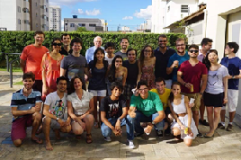
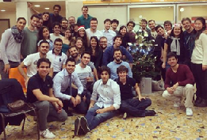
A long-term relationship between
ENCP & China
Remarkable works, designed by
Ponts Alumni
Academic partnerships, and Research cooperation
Long standing relations with top Universities
Brazilian students are #1 international students : 15 / year
  ENPC x EP-USP agreement : 23 years !
Active community of Alumni in Brazil (250 members)
Notes:
7

Slide 8
What is Ecole nationale des ponts et chaussées ?
A School with a long and prestigious history
  Creation by 1747 by King Louis XV
  Nobel prizes and renowned scientists
A unique combination of fundamental and applied sciences to transform business and society :
  Flexible and interdisciplinary engineering curriculum
  leading to top level positions in governments or companies
A world-class Higher Education and Research Institution
  Top 200 worldwide (QS) or top 500 (THE) in 2024
  Top 20 worldwide in 2024 for HEI < 5 000 students (THE)
  Top 11 in France en 2023 (L’Etudiant)
A public engineering school dedicated to the ecological transition :
  Reporting Ministry : Ministry for the Ecological Transition
  And the Ministry for Higher Education, Research and Innovation.
A School with an international outlook
A school with close links with industries

Slide 9

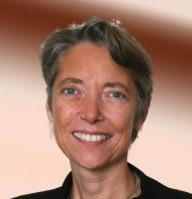

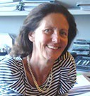

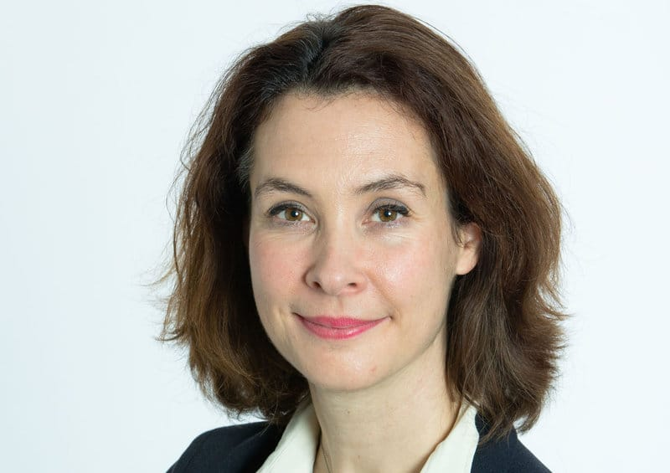
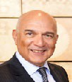
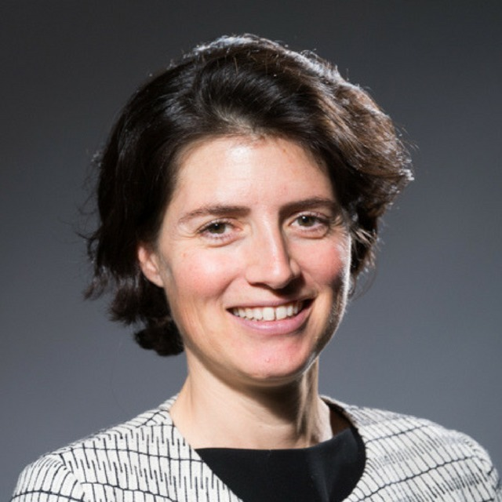
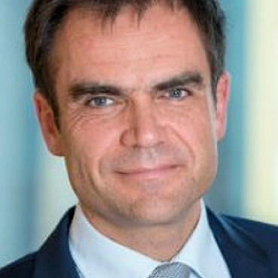
Alumni in industry and government
Benoit de Ruffray
Ponts 1993
CEO Eiffage
Diane D’Arras Ponts 77
Europe Delegate for Water, President IWA
Elisabeth Borne
Ponts 1986
Former Prime Minister, Minister Research & Education
Jean-Marc Samuelian
Ponts 2011
CEO Alan / Expliseat
Fabrice Fourcade
Ponts 19 89
Chairman EDF China
MostafaTerrab
Pont 1979
CEO OCP Group
Estelle Brachlianoff
Ponts 1997
CEO Veolia
Christelle Heydemann
Ponts 1997
CEO Orange

Slide 10
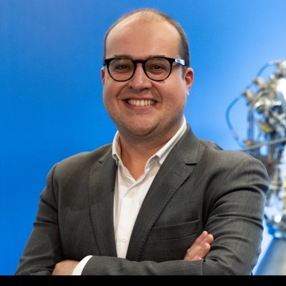
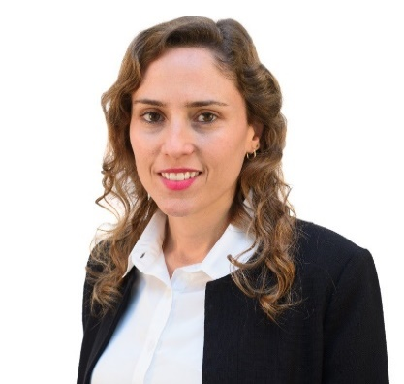
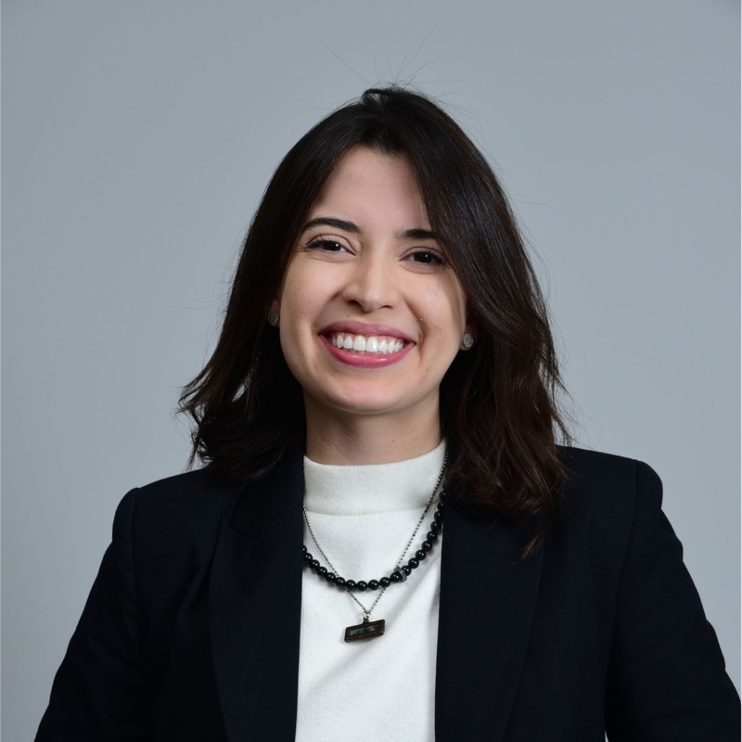

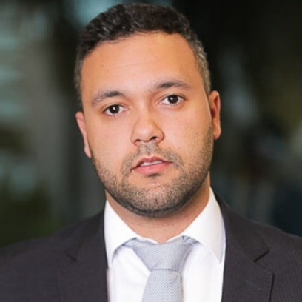
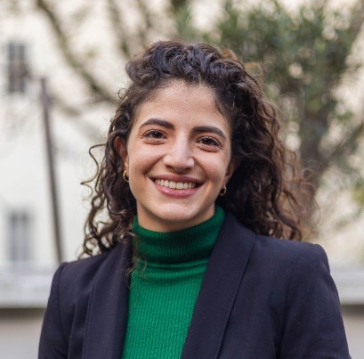
EP-USP ENPC double-degree alumni
Gustavo Rodovalho Boriolo (2015)
ThaIs Giorno Dantas Rabaneda Lopes (2013)
Isabella Ayres Pinheiro de Lima(2021)
Thiago Turri Tavares(2024)
Innovation Project Manager at Bouygues SA – Paris - France
Sr. Associate
H.I.G. Capital
Sao Paulo
Infrastructure Private Equity Patria Investments
Sao Paulo
Transport Analyst,
ALG
Sao Paulo
Students enrolled in Sept.2024
Américo da Silva Junior (2016)
Stéphanie Maalouf(2023)
Investment Banking
Vice President
BNP Paribas CIB
Paris- France
Solar Techno Manager
AKUO Energy
Paris - France

Slide 11
What is Ecole nationale des ponts et chaussées ?
A School with a long and prestigious history
  Creation by 1747 by King Louis XV
  Nobel prizes and renowned scientists
A unique combination of fundamental and applied sciences to transform business and society :
  Flexible and interdisciplinary engineering curriculum
  leading to top level positions in governments or companies
A world-class Higher Education and Research Institution
  Top 200 worldwide (QS) or top 500 (THE) in 2024
  N°3 in France (L’Etudiant) in 2024
A public engineering school dedicated to the ecological transition :
  Reporting Ministry : Ministry for the Ecological Transition
  And the Ministry for Higher Education, Research and Innovation.
A School with an international outlook
A school with close links with industries

Slide 12
What is Ecole nationale des ponts et chaussées ?
A School with a long and prestigious history
  Creation by 1747 by King Louis XV
  Nobel prizes and renowned scientists
A unique combination of fundamental and applied sciences to transform business and society :
  Flexible and interdisciplinary engineering curriculum
  leading to top level positions in governments or companies
A world-class Higher Education and Research Institution
  Top 200 worldwide (QS) or top 500 (THE) in 2024
  Top 20 worldwide in 2024 for HEI < 5 000 students (THE)
  Top 11 in France en 2023 (L’Etudiant)
A public engineering school dedicated to the ecological transition :
  Reporting Ministry : Ministry for the Ecological Transition
  And the Ministry for Higher Education, Research and Innovation.
A School with an international outlook
A school with close links with industries

Slide 13
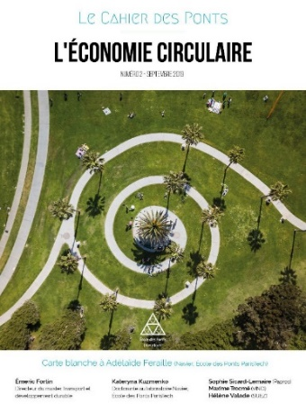
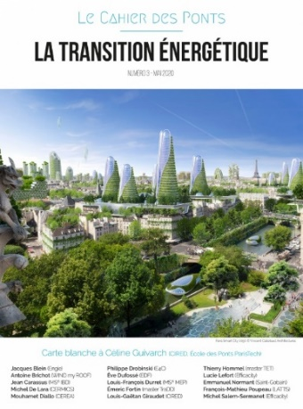
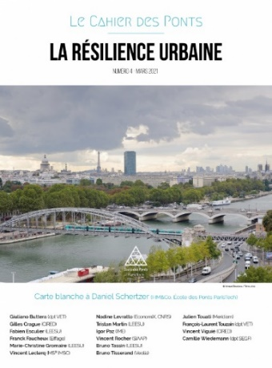
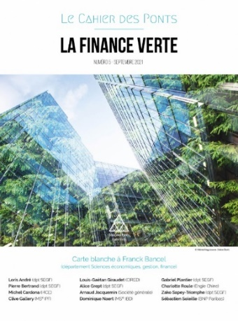
The School of the Ecological Transition
    Governing Ministry’s name : from Sustainable Development (2007-2017) to Ecological Transition (after 2017)
    A history of combining engineering and social sciences for effective, relevant and appropriate technologies
    12 Research centers covering 11/17 Sustainable Development Goals (United Nations)
    10/14 industrial chairs addressing the ecological transition: 3 in sustainable development, 2 in environment, 5 in sustainable transport and mobility
    Programs focusing on sustainability and transition
    One « European Research Institute » : Energy for Climate
    Develop’Ponts : the student union committed to sustainable development, solidarity actions, inclusion for the society and the environment

Slide 14

The Research at ENPC – 4 issues
      A challenge-based approach to address 4 socio-economic issues of sustainable development
Industry of the future
City and mobility systems
Economy, practices
and society
Management of risks, resources and milieus

Slide 15
The Research at ENPC – 12 labs
Ecomaterials
Digital Manufacturing
Innovative Structures
Geomechanics
Sustainable mobility
Territorial dynamics
NAVIER
LVMT
Modelisation of uncertainty
Digital simulation
Systems optimisation
Urban waters
Alternative resources
CERMICS
LEESU
Data processing
3D vision
Big data
LIGM
CEREA
Atmospheric environment
Air quality
Renewable energy
Cities of the future
Infrastructures
Practices
LATTS
HM&Co
Hydro-meteorological risks
Resilient cities
Public policies
Environmental economy
Markets and governance
PjSE
LMD
Physics of atmosphere
Climate
CIRED
LHSV
Renewable energy
Natural risks
Sustainable development
Climate change
More information on : https://ecoledesponts.fr/en/laboratories

Slide 16
What is Ecole nationale des ponts et chaussées ?
A School with a long and prestigious history
  Creation by 1747 by King Louis XV
  Nobel prizes and renowned scientists
A unique combination of fundamental and applied sciences to transform business and society :
  Flexible and interdisciplinary engineering curriculum
  leading to top level positions in governments or companies
A world-class Higher Education and Research Institution
  Top 200 worldwide (QS) or top 500 (THE) in 2024
  Top 20 worldwide in 2024 for HEI < 5 000 students (THE)
  Top 11 in France en 2023 (L’Etudiant)
A public engineering school dedicated to the ecological transition :
  Reporting Ministry : Ministry for the Ecological Transition
  And the Ministry for Higher Education, Research and Innovation.
A School with an international outlook
A school with close links with industries

Slide 17
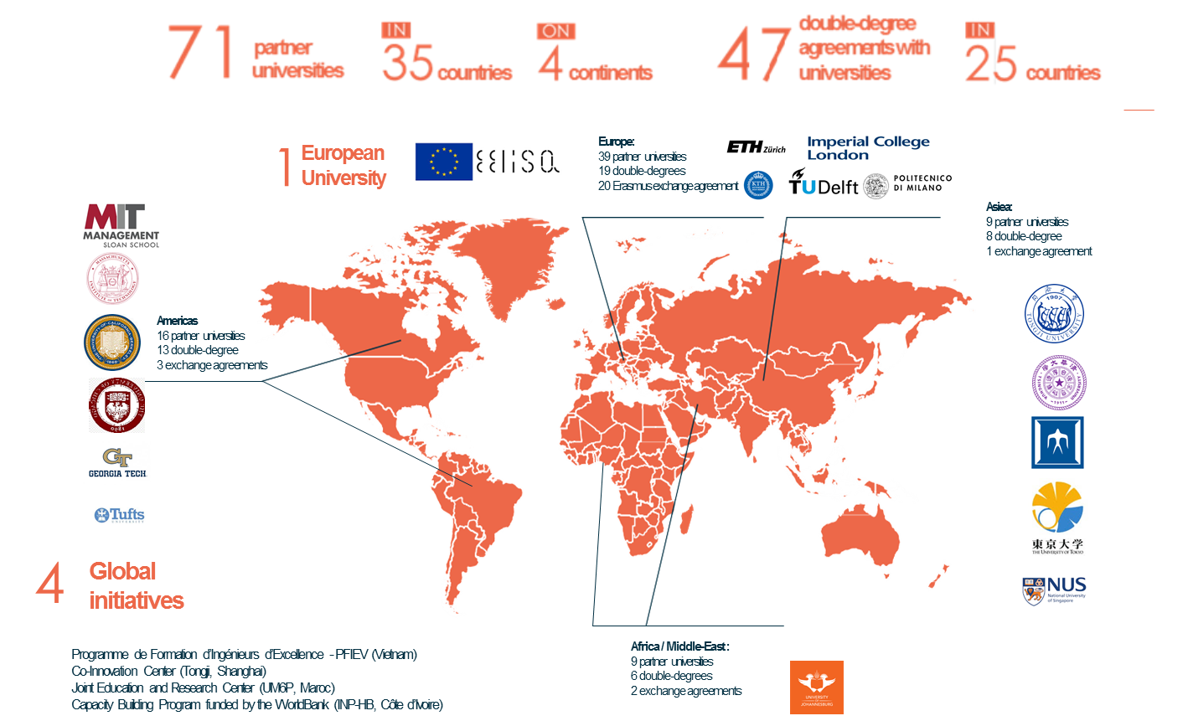










International partnerships

Slide 18

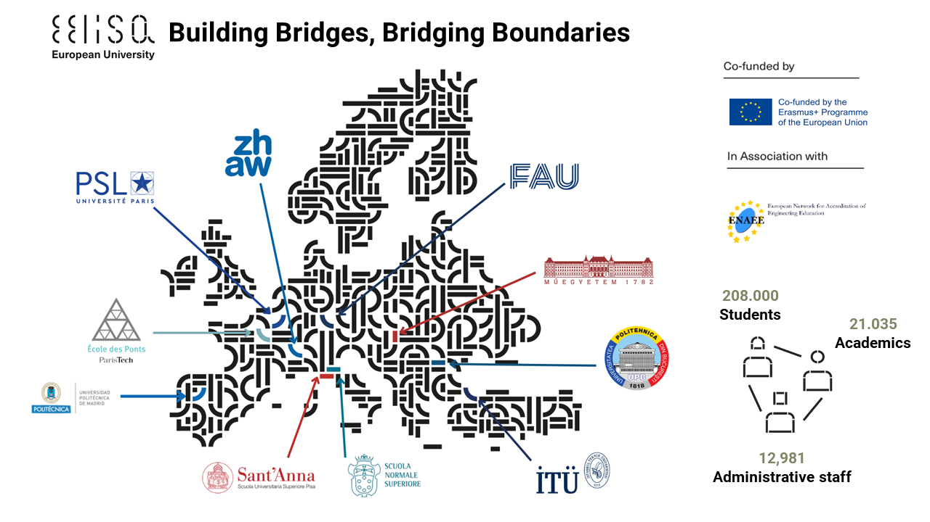
Example of international cooperation :
The European Engineer, for Sustainable Development Goals

Slide 19
What is Ecole nationale des ponts et chaussées ?
A School with a long and prestigious history
  Creation by 1747 by King Louis XV
  Nobel prizes and renowned scientists
A unique combination of fundamental and applied sciences to transform business and society :
  Flexible and interdisciplinary engineering curriculum
  leading to top level positions in governments or companies
A world-class Higher Education and Research Institution
  Top 200 worldwide (QS) or top 500 (THE) in 2024
  Top 20 worldwide in 2024 for HEI < 5 000 students (THE)
  Top 11 in France en 2023 (L’Etudiant)
A public engineering school dedicated to the ecological transition :
  Reporting Ministry : Ministry for the Ecological Transition
  And the Ministry for Higher Education, Research and Innovation.
A School with an international outlook
A school with close links with industries

Slide 20


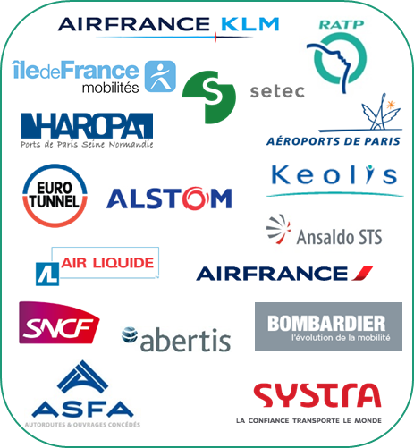









































Close links with industry
Energy
Teachers
Projects
Internships
Lectures
Chairs
…
Industry
Transportation
Environment
Urban services
Consulting
Construction
Finance
https://ecoledesponts.fr/en/learn-about-our-partners

Slide 21
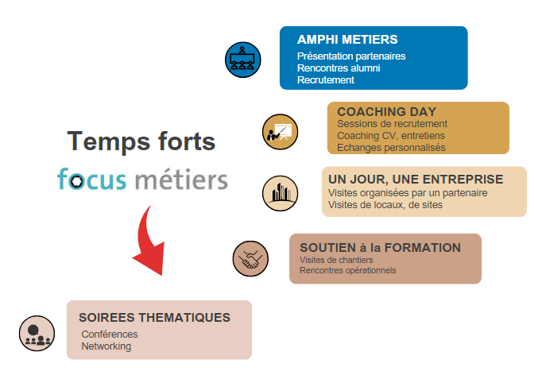
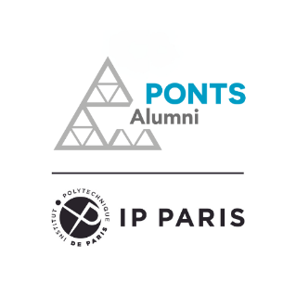

Career Events : discover, choose, create your path
Career Fair
With over 2400 companies participating
Conferences
Company presentations
Meetings with alumni
Recrutement
42% of students find a job during their master thesis at industry
Coaching day
Recruitment sessions
CV and interview training
Company visits
Construction site visits
Meetings with industry leaders
Buddy program with alumni
Industry-focus evenings
Conferences
Networking events

Slide 22
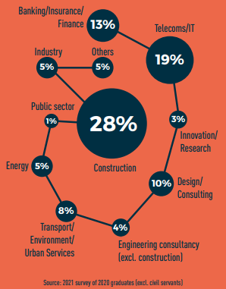
Careers and placement
AVERAGE SALARY
IN FIRST JOB
€ 48 000 57 000 € with bonuses
80% of engineering students are hired before graduation
15%
9%
7%
26%
5%

Slide 23
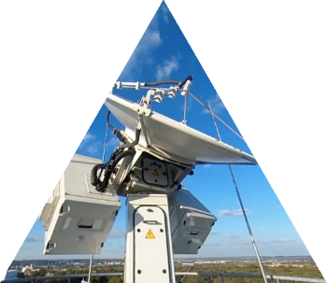
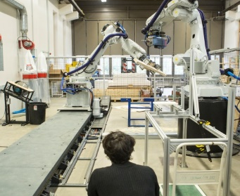
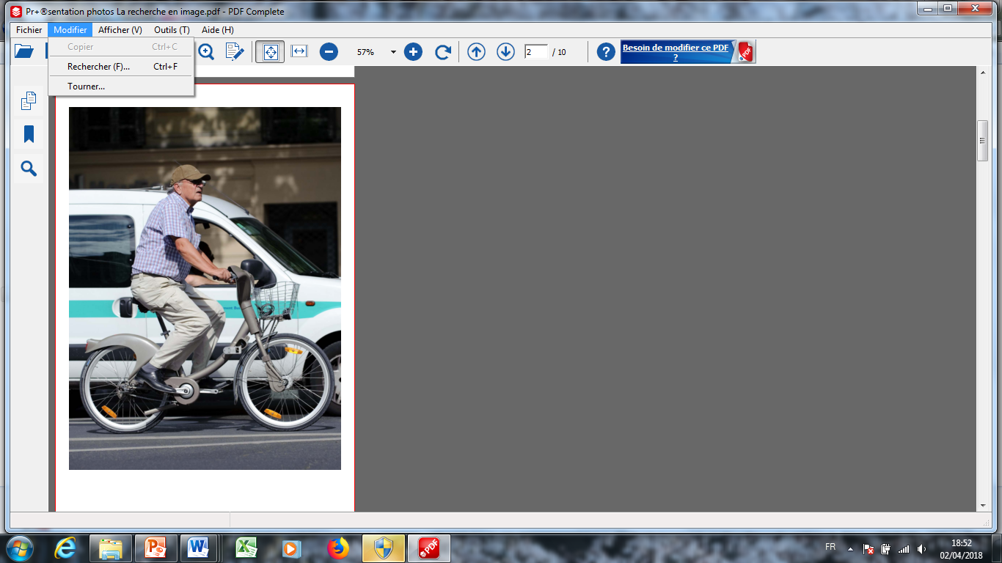
The Co-Innovation Lab
Collaborative platforms improving transfer to industry
Fresnel : multi-scale observation and modelling platform for resilient cities
X-band dual polarisation weather radar, lidars, disdrometer…
Build’In : building systems and artificial intelligence, materials and structures optimisation, industrial processes
Robotic hall, large-scale additive manufacturing unit, concrete and composite materials modelling …
Mµ : urban mobility modelling, new behaviors, infrastructures and urban planning, impact of public policies
Softwares, traffic simulators…
Notes:
...

Slide 24
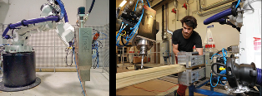
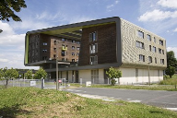
Maker space | d.school
Makerspace
3D Printing,
Laser cut
4 poles (ceramic, wood, steel, water, electronics)
d.School Paris
Design Thinking as an approach to innovation and its management
56 PARTNERS
CORPORATE
74 PROJECTS
PROFESSIONAL
100
ALUMNI EXPERTS
- innovate – collaborate – share -

Slide 25

Library, Heritage and Publishing.
La Source, Learning Center
250 seats
200 000 documents
Open 71 hours/week
Scientific information
services for researchers
25 000 scientific publications
HAL ENPC Open Science Plan (65% publications in open access)
Archives
Exceptional heritage
Ancient manuscripts and maps since the 18th century.
Presse des Ponts
220 books and scientific and technical software applications primarily in the fields of civil and structural engineering, and spatial planning

Slide 26
Engineering degree programme at
Ecole nationale des ponts et chaussées

Slide 27
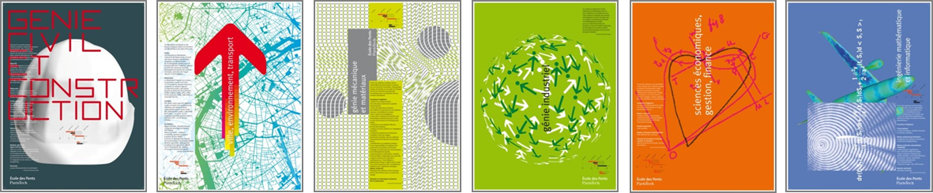
Our MSc in Engineering (« Diplôme d’ingénieur »)
NATIONAL STUDENTS ONLY
NATIONAL + INTERNATIONAL STUDENTS
CLASSES PREPARATOIRES 1 | CLASSES PREPARATOIRES 2 | YEAR 1 Sciences
SHORT INTERNSHP
(10 weeks)
▼
Competitive examination
Option 1
YEAR 2 Specialization | YEAR 3 Graduation project
Or
Option 2
YEAR 2 Specialization | GAP YEAR Internship (43 weeks) | YEAR 3 Graduation project
Civil and Structural Engineering | City, Environment, Transportation | Mechanical Engineering and Materials Science | Industrial Engineering | Applied Mathematics and Computer Science | Economics, Management, Finance

Slide 28
Your engineering degree at ENPC
2 year studies leading to the MSc in Engineering (Diplôme d’Ingénieur)
  Year 1 (Senior Bachelor level) : common core – transition year
  Years 2 & 3 (Master level) :
    Fundamental core courses : management, statistics & data analysis, law, language, sport …
    Specialization in one of four academic departments
    Choice of tracks in each department
    Mix of mandatory courses and elective courses which can be chosen in another department
    5 opening weeks including a 1 week study trip
    Year 3 : possibility to choose research-oriented courses in partner programs
27 week internship as a minimum
  End of Y1 : 4 weeks minimum
  Between Y2 & Y3 : short internship (10 weeks mini) or long internship (43 weeks mini) 90% of students take the long internship > fast access to employment
  Y3 – Semester 2 : End-of-study project (17 weeks minimum)
p.28

Slide 29
Double-degree curriculum for Brazilian students
Double Degree
At Ecole des Ponts :
120 ECTS to get the Ecole des Ponts diploma, composed by :
74 ECTS : scientific courses
ECTS : language
ECTS : sport
2,5 ECTS : internship
0,5 ECTS : professional orientation
30 ECTS : end-of-study project (PFE)
Within academic departments :
Common courses : management, statistics, law, human sciences
Compulsory courses of the department
Elective courses of the department
Opening weeks
B2 in French and English compulsory for graduation
Professionnal course
Semester 10
Semester 9
Semester 8
Semester 7
Semester 6
Semester 5
Semester 4
Semester 3
Semester 2
Semester 1
ENPC S6 – PFE
ENPC S5
Internship
ENPC S4
ENPC S3
ENPC S2
ENPC S1
Semester 4
Semester 3
Semester 2
Semester 1
Specialization
Fundametal course
Preparatory class
Fundamental course

Slide 30
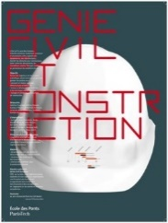
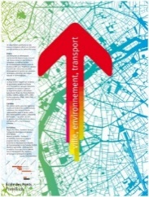



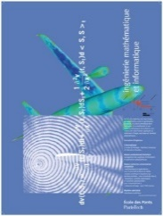
Academics: Departments of studies
Civil and Structural Engineering
Complex projects, site work organisation, innovation of new materials and construction technologies
Industrial Engineering:
Innovation and supply chain
City, Environment, Transportation
Planification of complex urban systems and operation of urban services (transportation, water,…)
Mechanical Engineering and Material Science:
Research and design of new products and materials in the fields of energy or transportation
Economics, Management, Finance:
Financial engineers : financial engineering, project finance, public/private partnerships
Economist engineers : urban, environment, transportation, construction and economic regulation
Applied Mathematics and Computer Science:
Modelisation of complex systems ; analysis of financial, industrial or natural risks ; challenges presented by big data and artificial intelligence
More information : https://ecoledesponts.fr/en/academic-departments

Slide 31
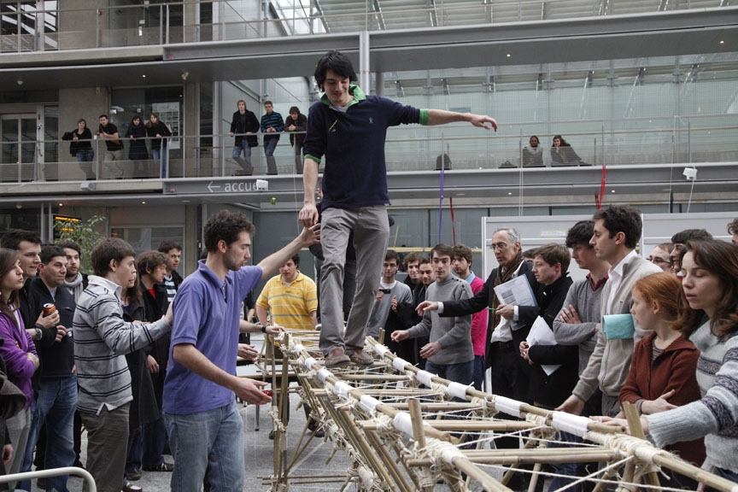
Civil and Structural Engineering
Check the course list and the scientific pre-requisites :
https://ecoledesponts.fr/en/civil-and-structural-engineering
Fundamentals of the programme Theoretical bases of mechanics and dynamics, applied to structures, soils and fluids In-depth teaching in geotechnics, structures or energy issues, mixing theoretical courses and projects 2 long projects : building, bridge, port, road or dam ; Several specific courses covering all the aspects of civil engineering and construction to be chosen among a large variety of courses : advanced dynamics, physics of fire, special-risk structures, steel construction, wooden contruction, management of construction projects … Department trip : introduction to geology and construction materials Joint tracks with our City Environment Transportation department Transport and infrastructure Urban planning and infrastructure Close links with Navier, in charge of several industrial chairs : Maintenance of Road structures (Sanef Abertis) Sciences for rail transportation (Getlink) Science of Materials for Sustainable Construction (Lafarge Holcim) Job opportunities Construction Public works Structures Geotechnics Structures for Energy Marine Engineering

Slide 32
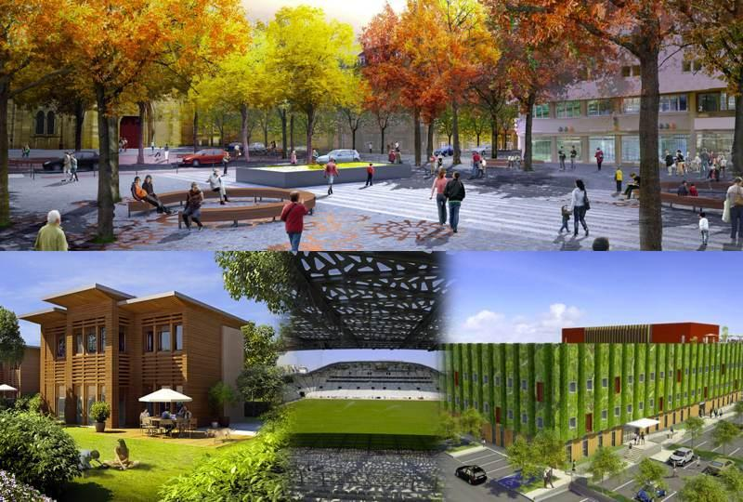
City Environment Transportation
Check the course list and the scientific pre-requisites :
https://ecoledesponts.fr/en/city-environment-transportation
OBJECTIves and strengths of the programme Training engineers capable of designing and carrying out the challenges that cities face, in relation with climate change : optimization of current solutions, development of new infrastructures compatible with the transition and massification of the most efficient solutions Application of strong skills in mathematics and modeling to the main challenges faced by cities Programme focusing on field work on issues like : land artificialisation, housing, transport engineering hydrology …. Strong links with laboratories (LEESU, LVMT, LHSV, HM&CO, LATTS …) on topics like : Water management in urban areas - Renewable energy Sustainable mobility - Resilient cities 3 tracks : Urban planning : territorial analysis, economics, city and regional planning … Environment : hydrology, energy, environmental risks, air quality … Transportation : transportation systems, traffic engineering, economics, … Job opportunities : Great variety of positions in public and private sector : Infrastructure operators : roads & highway, waste management, water … Consultancy in environment, transportation & urban planning Government or local authorities Research

Slide 33

Mechanical Engineering and Materials Science
Check the course list and the scientific pre-requisites :
https://ecoledesponts.fr/en/mechanical-engineering-and-materials-science
OBJECTIves and strengths of the programme Solid command of concepts and tools of materials mechanics Pedagogical approach giving priority to workgroup and learning though action Close links with the industry : Chair Sustainability of Materials and Structures for Energy (EDF), close contacts with engineers, … Close links with the Research 2 tracks in 2A : Design of Industrial systems track Modeling track Job opportunities : Research, development and design of new materials Product manager or Manager of industrial programme Example : Manager of a programme aimed at developing a new vehicle

Slide 34

Industrial Engineering
Check the course list and the scientific pre-requisites :
https://ecoledesponts.fr/en/industrial-engineering
OBJECTIves and strengths of the programme Training engineers and future managers capable of designing new industrial models and supporting the industry mutations : ecological and digital transformation, new technologies (Big data, IA, IoT, additive fabrication …), increased competition … Close links with companies : Chair in Supply Chain (Louis Vuitton, Michelin, Renault, Decathlon), company projects … Programme focusing on the design, improvement and optimization of complex industrial systems with an emphasis set on : Planning and modeling of production systems - Software development - Design thinking Tools for modeling and simulation - Operative research - Supply Chain Mgt 2 tracks in 2A : Engineering of Design and Innovation Engineering of Operations and Optimization Job opportunities : Great variety of positions : Supply chain manager Product manager (in design) Production manager Data analyst Expert in operative research Manager of a BU Many economic sectors : luxury, automotive, aviation, cosmetics, energy, telecommunication, agri-business, construction, …. + Consulting

Slide 35


An entrepreneurial ecosystem for students
    Entrepreneurship courses
    2 incubators (Descartes, Station F), 1 accelerator
    Annual Hackathon: « One night to innovate»
    Access to research equipment and mentorship
    Special awards, and seed-funds from Fondation des Ponts

Slide 36




  Campus Cité Descartes
  Greater Paris green cluster
20’ from Paris center (direct urban train)
Housing (on campus or in Paris center)
French classes throughout your path at ENPC
Buddy program with alumni
Sport facilities
Vibrant campus life : near to 40 student societies
International students welcome desk with « Feel Français »

Slide 37
Financial and practical issues
Registration fees for international students : 4 800€/year (2025-2026)
+ CVEC (Governmental tax) : 103 €/year (2025-2026)
Total registration fees for your engineering degree : 9 600€ if you opt for the short internship
                10 540€ if you opt for long internship
Living cost in/near Paris : 800€/month
For more information : https://www.campusfrance.org/es/preparar-presupuesto-estudiante-Francia
Scholarships :
  Eiffel Excellence scholarship
  Fondation des Ponts
  Meridiam scholarship (investment corporate partner)
  Need-based scholarship on social criteria, granted by ENPC
Living costs :
Accommodation : offered in a student’s residence 2’ away from the school :
  Individual or shared housing
  400 to 650 €/months, minus 150 € Government allowance
  Housing is guaranteed for your first year at ENPC.
Support by an experienced partner for administrative procedures :
  Visa and renewal
  Registration to the French Social Security Scheme
  Insurances, bank account, transportation card …
Net allowance during your internship and your final year project :
- In public sector (including research centers) : ~600€~/month
- at industry and private sector : 1400-1600€/month

Slide 38
Application and selection process
  European Autumn session
Phase | Nomination by EP-USP | Application online | Remote Interview | ENPC Admission Jury | Deadline for sending certificates | Beginning of the academic year
Deadline | Early September | September 30th | Mid-October | Mid- November | Early June | Last week of August
Criteria | GPA Ranking by class Statement of purpose Letters of recommendation | https://crm.enpc.fr/community/enpc/custom_forms/184 | 30mn Motivations | Academic excellence Clarity of the project Recommendation letters Interview Maximum 6 students Maximum 4/departement | A2 in French (B1 for VET Urban planning track) TOEIC 785 | Assessment of language level, and upgrading courses in mechanics (in September)
  Application process
  European Spring session : for non degree exchange students only (2 semesters of coursework)
Phase | Nomination by EP-USP | Application online | Remote Interview | ENPC Admission Jury | Beginning of the academic year
Deadline | Mid March | March 31st | Mid-April | Early May | Last week of August
Criteria | GPA Ranking by class Statement of purpose Letters of recommendation | https://crm.enpc.fr/community/enpc/custom_forms/184 | 30mn Motivations | Academic excellence Clarity of the project Recommendation letters Interview Maximum 3 students | Assessment of language level,

Slide 39


Alumni endowment and support
20 000 alumni worldwide, holding leadership positions in 100 countries
14 international groups
Bespoke mentoring for international students over their stay in France
Support for careers and internships
Special scholarships program for international students
Corporate Scholarship (Meridiam)
Excellence awards
A powerful network of donors

Slide 40
ecoledesponts.fr/en
Contacts @ ENPC :
Marie-Christine BERT, Director of International Relations :
marie-christine.bert@enpc.fr
Emmanuel SIMANTOV, Head of International Mobility
Emmanuel.simantov@enpc.fr
www.ecoledesponts.fr/en

Slide 41
MAY 2025
L’ÉCOLE NATIONALE DES PONTS ET CHAUSSÉES
Building the worlds of tomorrow
www.enpc.fr/en

